Slide 1
Data migration preparation and execution
Peter Prokopecz

Slide 2


Slide 3

Speaker Introduction
Peter Prokopecz
AX technical lead @ JJ Food Service Ltd. (Food wholesale)
Owner @ DAXVision ERP Consulting Ltd. (Your external AX tech. team)
http://www.daxvisionerp.com/
info@daxvisionerp.com
Studies: IT engineer (2006) + MBA (2019)
Experience: AX from 2003 – Trade and logistics, Developing, Technical architect
Lived in: Budapest (Hungary), Dubai (UAE), Cambridge (UK), Gent (Belgium)
Loves doing sport, ultra distance running

Slide 4
Agenda
Initial thoughts
The process (preparation, execution, test, rerun…)
DMT tool
More about execution – tricks
Lessons learned

Slide 5
Initial thougts

Slide 6
AX2009 or earlier? AX2012? Other software?
https://docs.microsoft.com/en-us/dynamics365/fin-ops-core/dev-itpro/migration-upgrade/upgrade-home-page
Data migration from AX2012 possible, like from any other ERP or software
Data upgrade is possible, so you can do an upgrade-export-import
Consider FastTrack https://docs.microsoft.com/en-us/dynamics365/fasttrack/

Slide 7
The process

Slide 8
Process
1.Project Preparation
2.Preparation of source data
3.Preparation in D365FSCM
4.Executing export/import/basic validation
5.Test and validate
6.Conclusions, export, rerun

Slide 9
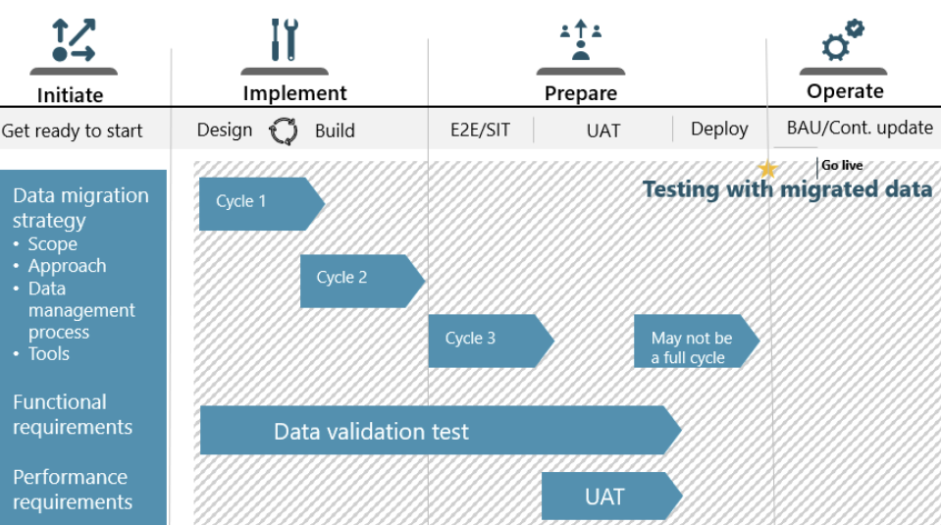
https://docs.microsoft.com/en-us/learn/modules/data-migration/4-workshop-topics

Slide 10
1.Project preparation
Fast Track
Build the team – technical and functional knowledge
Upgrade or migrate or combined
What data
Number of migration cycles?

Slide 11
2.Preparation of source data
Purge and archive
What data (next slide) - https://www.daxrunbase.com/2022/03/31/identify-tables-to-migrate/
(custom tables!)
Source system still in use – create the import files once or repeatedly
How to migrate
Manual migration
Migrate once then use it for ever
Incremental (update only if there is natural key, filter?)
++Upgrade than export
Opening transactions (cutover week, closing, parallel processing?)
Fix:
Duplicate keys
Mandatory fields
Missing related data
Natural keys (specially Recid in AX 2012)
Identify changed tables – valid time state, index change
Write scripts to find data based on configuration key, number of records, index usage (XML, X++, TSQL)

Slide 12
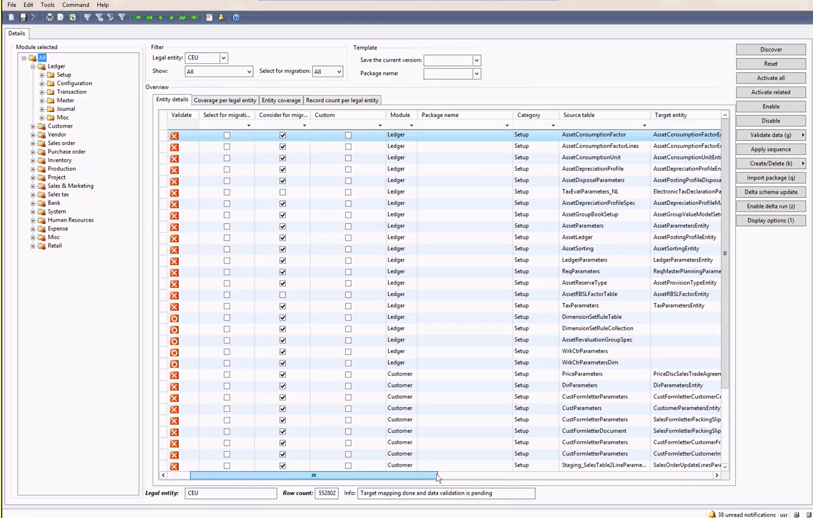
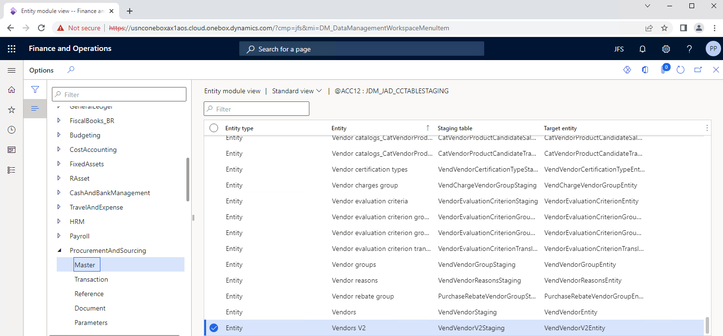
2.Preparation of source data

Slide 13
3.Preparation in D365FSCM
Create and extend D365 entities – (lots of entities do not exists or do not match) https://www.youtube.com/watch?v=eEtr4vGzSYs
Technical code upgrade done at least on the metadata level (parallel processing of migration and code upgrade)

Slide 14
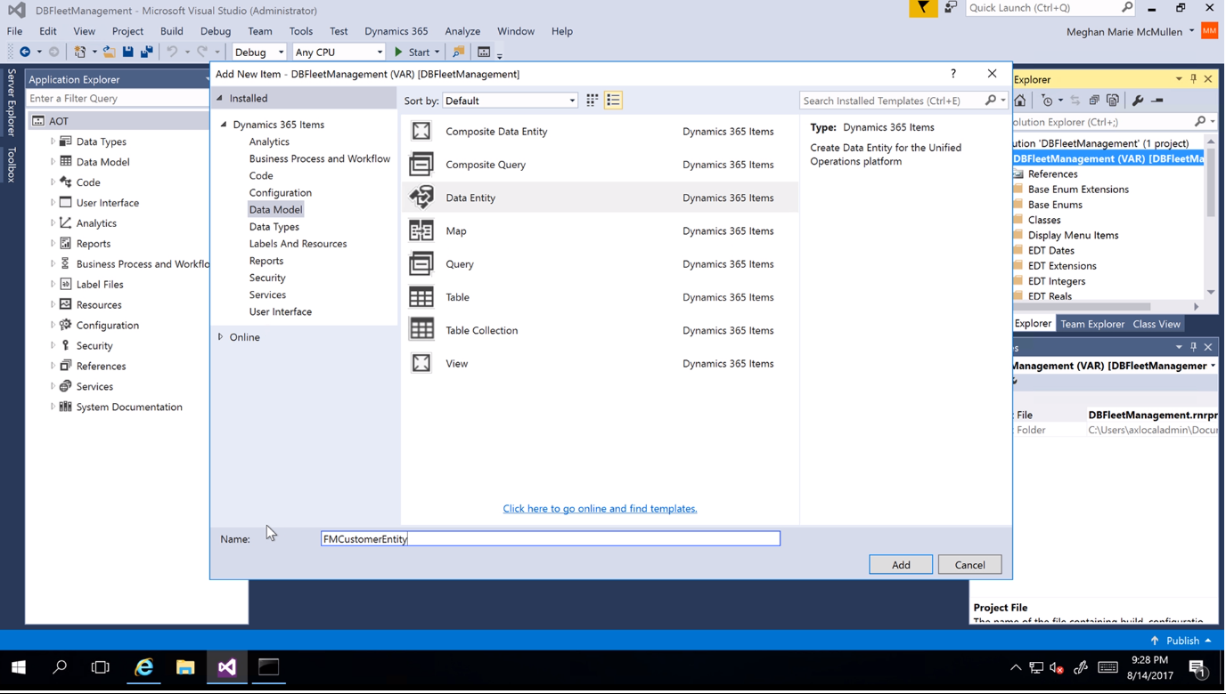
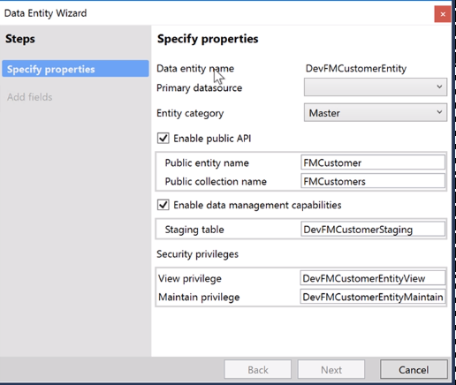
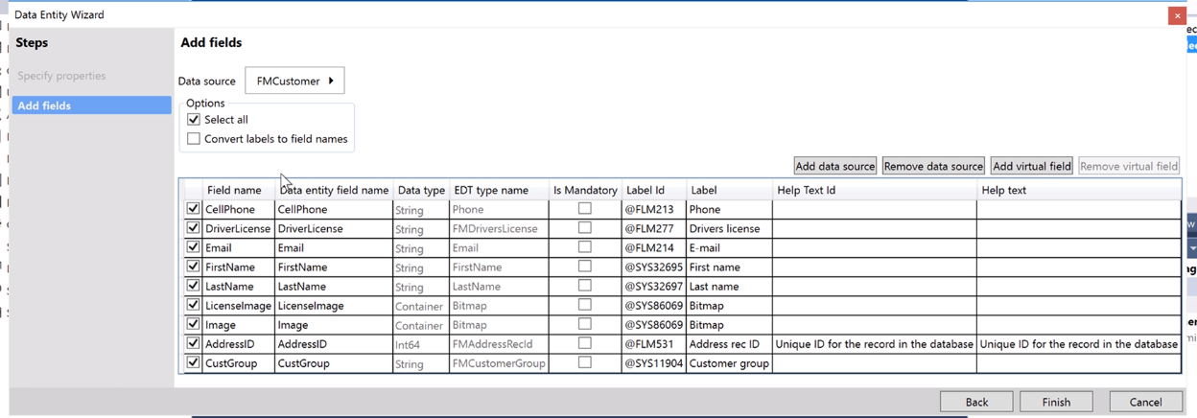
Creating Data entities

Slide 15
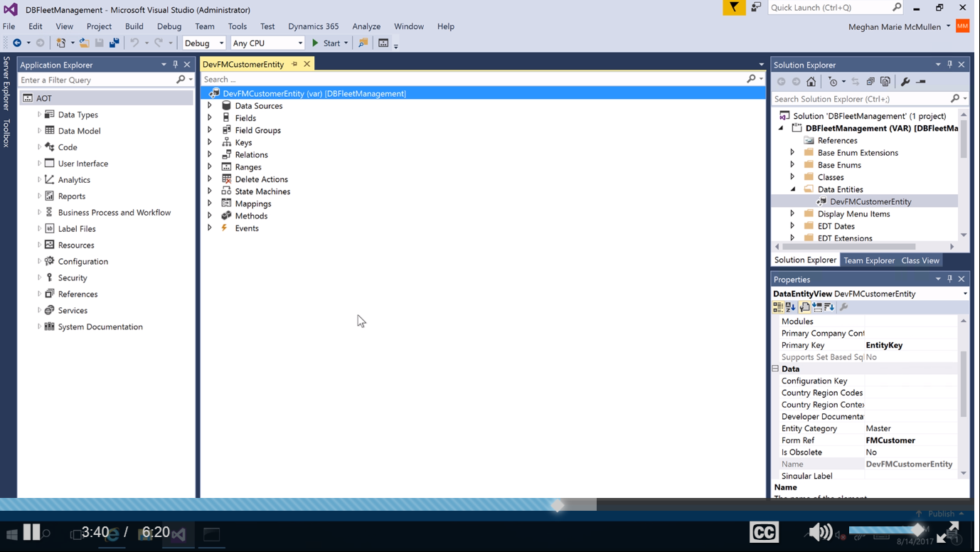
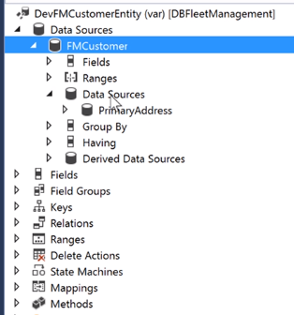
Data entity in AOT

Slide 16
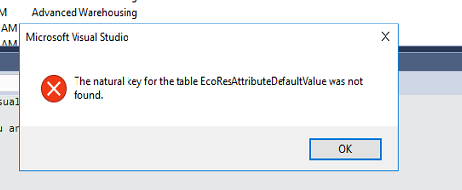
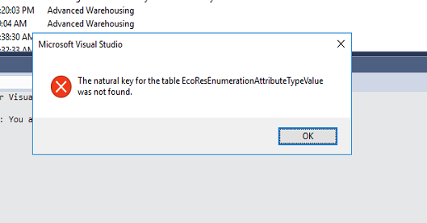
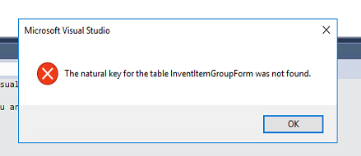
3.Preparation in D365FSCM
Create entity for standard table with no natural key
DEMO (InventItemGroupForm)

Slide 17
4.Executing export/import/basic validation
DMT tool – next
View/Form/etc – excel – fields naming & labeling
DEMO (DirExternalRole)
https://usnconeboxax1aos.cloud.onebox.dynamics.com/?cmp=jfs&mi=SysTableBrowser&TableName=InventItemGroupForm
&mi=SysTableBrowser&TableName=CustTable
&mi=CustTable
&f=CustTable
Technical validation of record count and data (TSQL)
https://www.daxrunbase.com/2022/03/31/sql-record-count-by-company/
More about execution - next

Slide 18
5.Test and validate
Code upgrade completed mostly
Compare record count
Forms open
Functions work
Be prepared for some debugging – ”Object reference not set to an instance of an object”

Slide 19
6.Conclusions, export, rerun
Export data that could be used in next cycle
Do an upgrade cycle?
Need for next cycle? How many? Incremental or new?
UAT/Golive etc

Slide 20
DMT tool

Slide 21
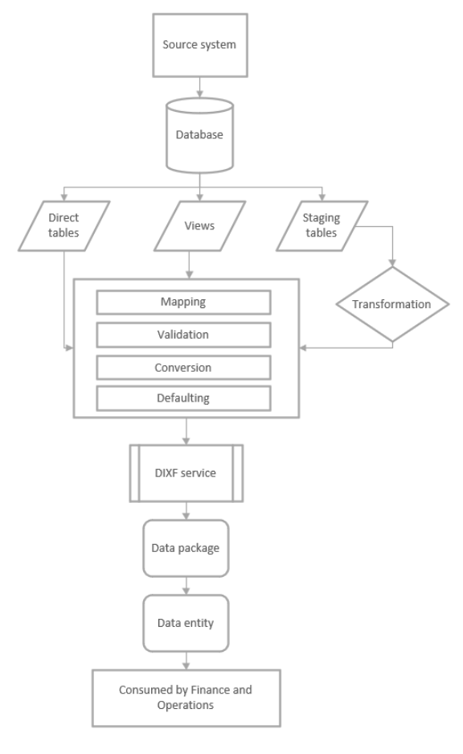
DMT
Preview Program
https://www.youtube.com/watch?v=kdQ58arACP4
https://community.dynamics.com/365/dynamics-365-fasttrack/b/techtalks/posts/ax2009-migration-tool-may-11-2017

Slide 22
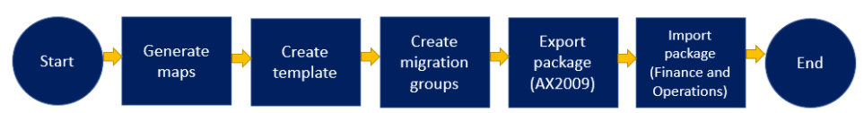
DMT
Mapping the table fields between the source and target environments
Applying conversions to the source data
Setting up default values for the source data
Applying query filters

Slide 23
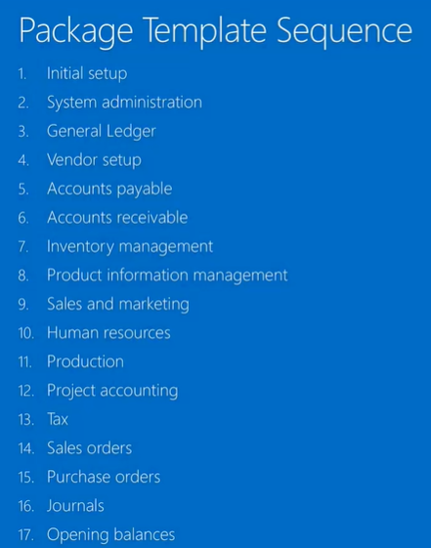
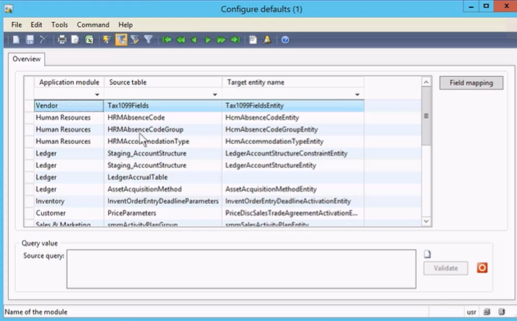
Source to target mapping

Slide 24
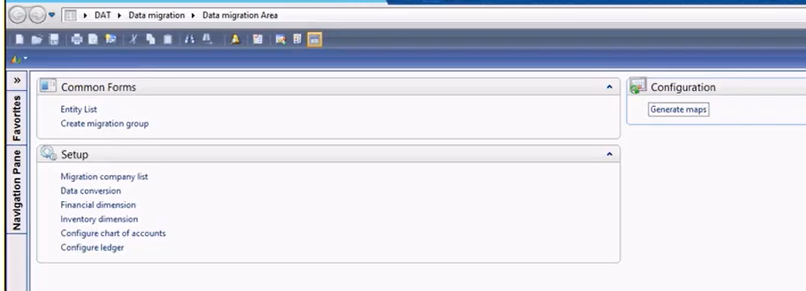
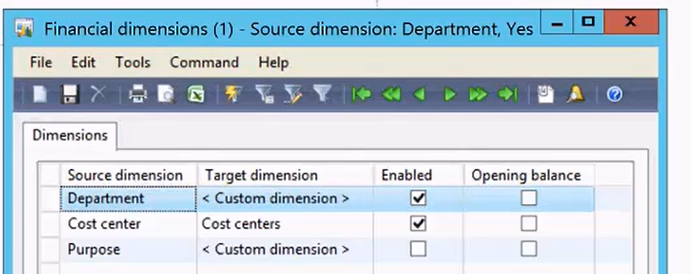
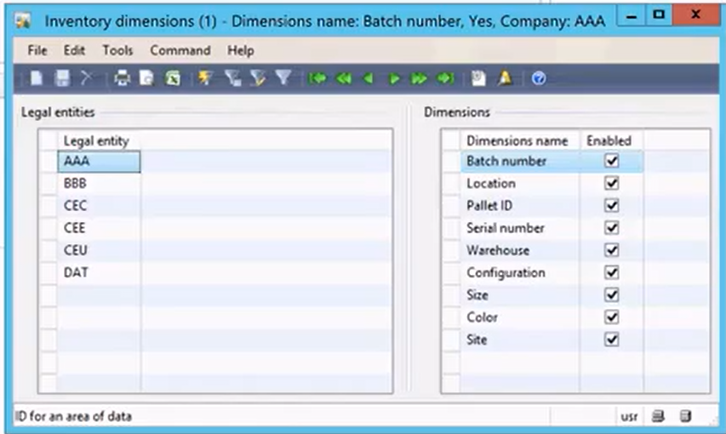

Slide 26
More about execution - tricks

Slide 27
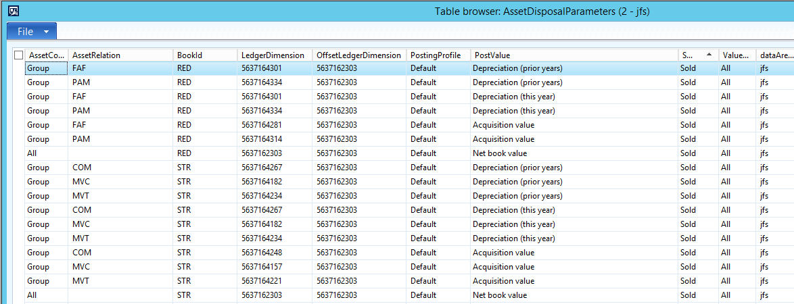
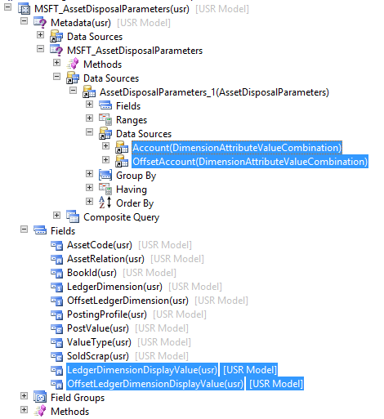
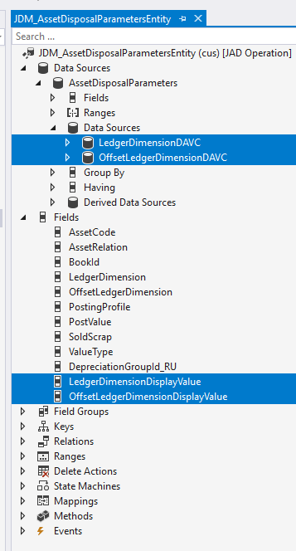
DAVC

Slide 28
Tricks
Package files
Create a view and export the data
Create a form and export the data
Find the D365 entity –
SELECT BackendTableName,TargetEntityName FROM DMTTargetTableSchema
group by backendtablename,TargetEntityName
having
BACKENDTABLENAME = 'INVENTITEMPRICE'
select * from INVENTITEMPRICE

Slide 29
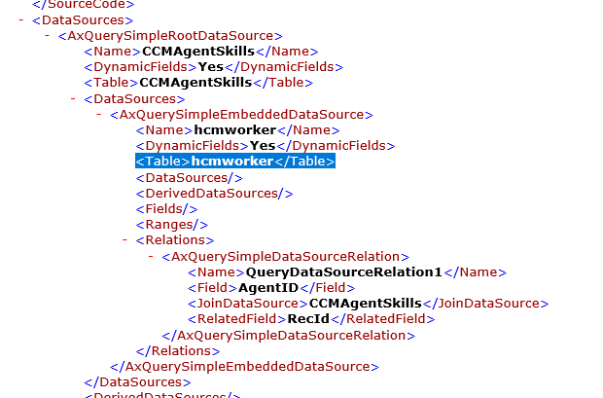
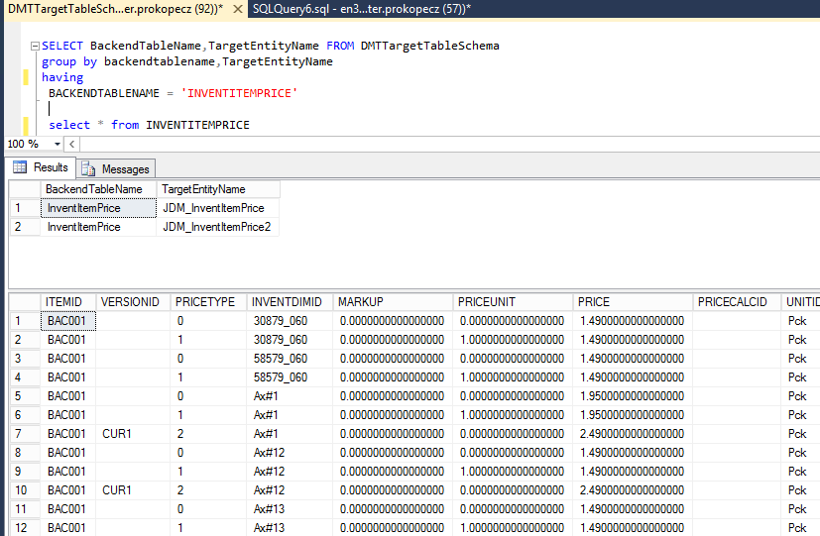
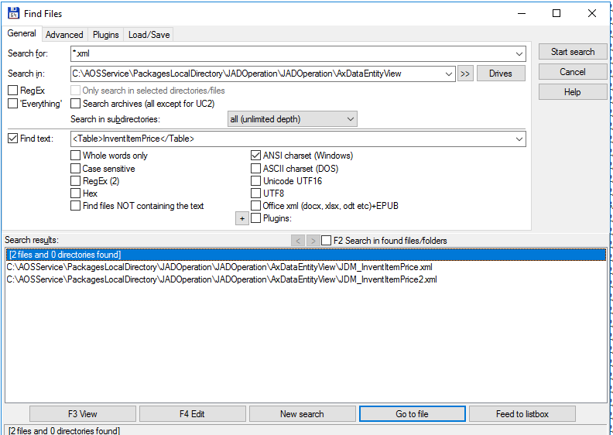
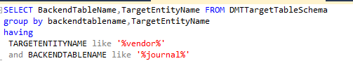
Tricks – Find the data entity

Slide 30
Tricks
Set based – in case of error the whole import fails, but runs faster
Clean staging tables
We recommend that you clean up the staging tables. You can achieve this optimization by scheduling the Job history cleanup job. To schedule this job, select the Job history cleanup tile in the Data management workspace.
Update statistics
Before you run a data migration job that involves a large volume of data, consider updating the statistics across the associated tables. This optimization applies specifically to sandbox environments, because it's handled automatically in production environments. You can update statistics for a specific table from LCS. Alternatively, in a sandbox environment, you can use the sp_updatestats stored procedure through direct SQL.
Break up large files into smaller chunks.
Configure and use batch
Enable set-based processing
Disable change tracking
https://docs.microsoft.com/en-us/dynamics365/fin-ops-core/dev-itpro/sysadmin/optimize-data-migration

Slide 31
Validations
Validations
If the data migration is mature enough, the time that is spent on imports can be significantly reduced by disabling this validation, if it can be disabled.
Follow these steps to change the settings for each entity.
In the Data management workspace, select the Data entities tile.
On the Target entities page, select the entity in the grid, and then, on the Action Pane, select Entity structure.
On the Entity structure page, set the Run business validations and Run business logic in insert or update method fields as appropriate.
Run business validations
If this check box is selected, the system will run any logic that is written into the validateWrite() method on the table. It will also run any related event handlers.
Run business logic in insert or update method
If this check box is selected, the system will run any logic that is written into the insert() or update() method on the table. It will also run any related event handlers.
https://docs.microsoft.com/en-us/dynamics365/fin-ops-core/dev-itpro/sysadmin/optimize-data-migration

Slide 32
Lessons learned

Slide 33
LESSONS LEARNED
Time fields – divide by 60*60*24 =86400
Financial dimensions migration - Financial dimension configuration for integrating applications
Standard entity: It is marked for export only. You cannot import data. Duplicate?

Slide 34
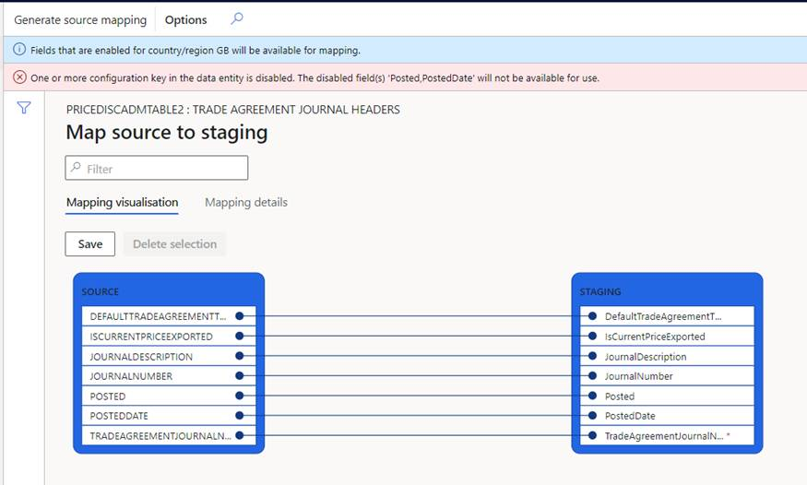
LESSONS LEARNED
Match config keys between old and new AX
EP config key
The field properties in target are:
Allow edit = false
Allow edit on create = false
Mandatory = true
Just I skip the insert validation
No natural key
Break up complex entities with many datasources to more separate imports
Datasource import and export language should match (EN-US vs EN-GB – enum lables)

Slide 35
Recap

Slide 36
What have I talked about
Initialthoughts
The process (preparation, execution, test, rerun…)
DMT tool
More about execution – tricks
Lessons learned

Slide 37
Sources
https://docs.microsoft.com/en-us/dynamics365/fin-ops-core/dev-itpro/migration-upgrade/data-migration-tool
https://docs.microsoft.com/en-us/dynamics365/fin-ops-core/dev-itpro/sysadmin/optimize-data-migration
https://docs.microsoft.com/en-us/learn/modules/data-migration/4-workshop-topics
https://view.officeapps.live.com/op/view.aspx?src=https%3A%2F%2Faxmartina.files.wordpress.com%2F2019%2F10%2Fdmt-from-ax2009-to-d365-1.docx&wdOrigin=BROWSELINK
https://www.daxrunbase.com/2022/03/31/identify-tables-to-migrate/
https://www.youtube.com/watch?v=eEtr4vGzSYs
DAXVisionERP.com
Preview Program
https://www.youtube.com/watch?v=kdQ58arACP4
https://community.dynamics.com/365/dynamics-365-fasttrack/b/techtalks/posts/ax2009-migration-tool-may-11-2017

Slide 38
Thank you
Peter Prokopecz
info@daxvisionerp.com
DAXVision ERP Consulting Kft.
http://www.daxvisionerp.com/
https://www.linkedin.com/in/peter-prokopecz/
https://www.linkedin.com/company/daxvision

